Slide 1
Microsoft C Sharp
Basic Programming Constructs

Slide 2
topics
Decision & Selection
Relational Operator
IF Statement
IF-ELSE
Nested IF
IF within IF
ELSE-IF
Switch Case

Slide 3
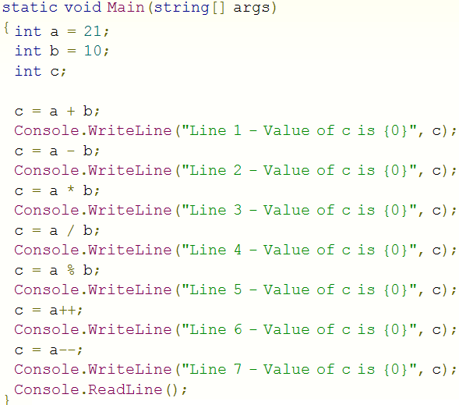
Decision & Selection
Sequential
Flow
of a program

Slide 4
Relational Operator
X == Y
X != Y
X < Y
X <= Y
X > Y
X >= Y

Slide 5
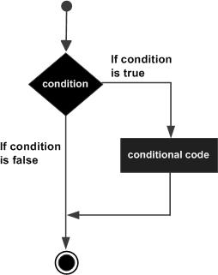
IF Statement
if(<condition>)
statement
if(<condition>)
{
statement
statement
}

Slide 6
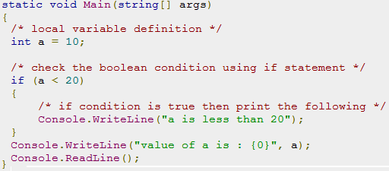
Example

Slide 7
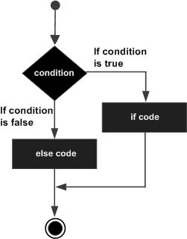
IF-ELSE Statement
if (<condition>) statement else statement | if (<condition>) { statement statement } else { statement statement }

Slide 8
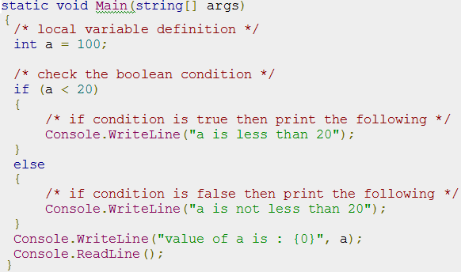
Example

Slide 9
Nested IF
if (<condition>) { statement if (<condition>) statement else statement statement } else …. | if (<condition 1 >) statement 1 else if (<condition 2>) statement 2 else if (<condition 3 >) statement 3 else if (<condition 4 >) statement 4 else statement 5

Slide 10
Problem 1
Input : X as Integer Number
Output:
Number X is EVEN
OR
Number X of ODD

Slide 11
Problem 2
Input : Day as Number
Output:
Monday for 1
Tuesday for 2
….
Sunday for 7
Invalid Number for anything else

Slide 12
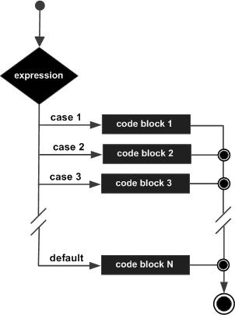
Switch-Case

Slide 13
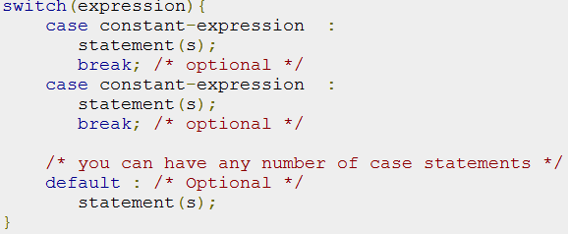
Switch-Case

Slide 14
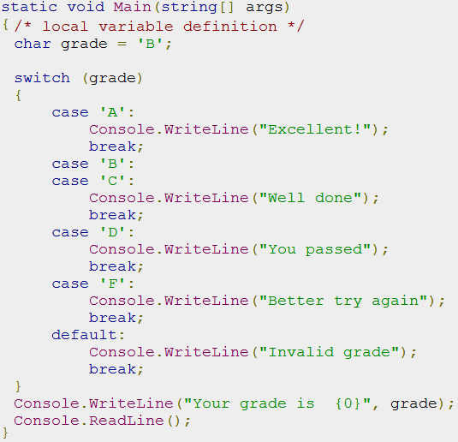

Slide 15
Logical Operators
Combining multiple conditions
AND &&
OR ||
NOT !
To check 20 <= x <= 30
if( (a >= 20 ) && ( a <= 30 ) )

Slide 16
